Slide 1
Lab 9: Polynomial Interpolation (Chapter 17)
BME 313L Introduction to Numerical Methods in Biomedical Engineering
2017 Spring

Slide 2
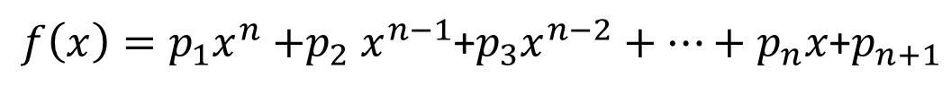
MATLAB Functions
MATLAB has a built-in function polyfit that fits a least-squares nth order polynomial to data:
p = polyfit(x, y, n)
x: independent data
y: dependent data (length(x) = length(y))
n: order of polynomial to fit
p: coefficients of polynomial (starting with the highest order)
For n+1 data points, there is one and only one polynomial of order n^{th} that passes through all the points.
MATLAB’s polyval command can be used to compute a value using the coefficients.
y = polyval(p, x)
$f\left(x\right)=p_{1}x^{n}{+p}_{2}x^{n−1}$+$p_{3}x^{n−2}+…+p_{n}x$+$p_{n+1}$

Slide 3
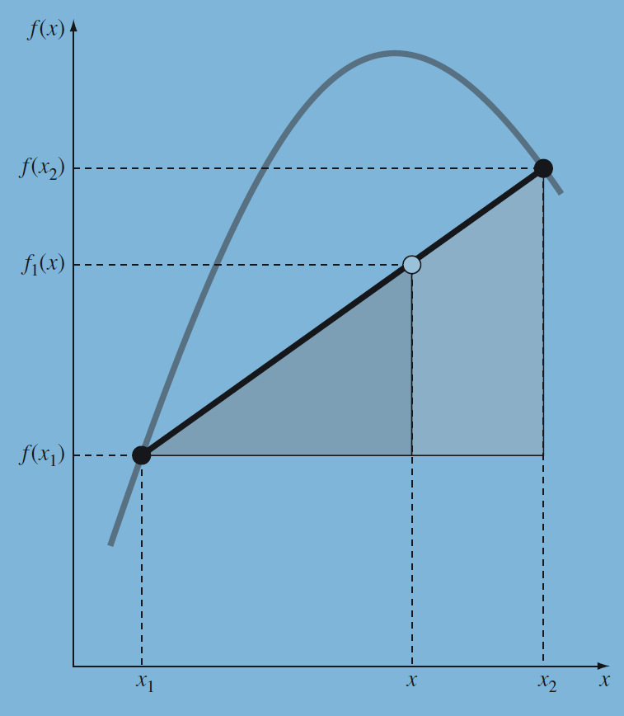
Newton’s interpolating polynomial
Linear Interpolation: 1st order
Quadratic Interpolation: 2nd order

Slide 4
Example 17.4
Finite divided differences
x | f(x) | First | Second
1 | 0 | 0.4620981 | -0.0518731
4 | 1.386294 | 0.405465
6 | 1.791759
= 0

Slide 5
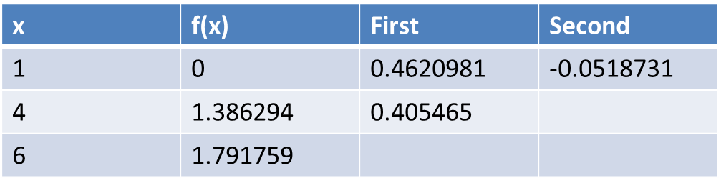
function yint = Newtint(x,y,xx)
% Newtint: Newton interpolating polynomial
% yint = Newtint(x,y,xx): Uses an (n - 1)-order Newton
% interpolating polynomial based on n data points (x, y)
% to determine a value of the dependent variable (yint)
% at a given value of the independent variable, xx.
% input:
% x = independent variable
% y = dependent variable
% xx = value of independent variable at which
% interpolation is calculated
% output:
% yint = interpolated value of dependent variable
% compute the finite divided differences in the form of a
% difference table
n = length(x);
if length(y)~=n, error('x and y must be same length'); end
b = zeros(n,n);
% assign dependent variables to the first column of b.
b(:,1) = y(:); % the (:) ensures that y is a column vector.
for j = 2:n
for i = 1:n-j+1
b(i,j) = (b(i+1,j-1)-b(i,j-1))/(x(i+j-1)-x(i));
end
end
% use the finite divided differences to interpolate
xt = 1;
yint = b(1,1);
for j = 1:n-1
xt = xt*(xx-x(j));
yint = yint+b(1,j+1)*xt;
end
b(1,:)
b(2,:)
b(3,:)
= 0

Slide 6
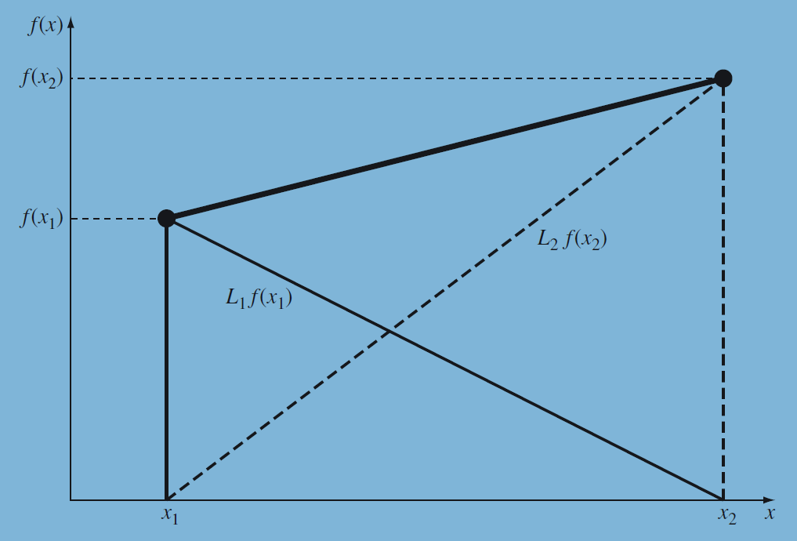
Lagrange interpolating polynomial
Lagrange Interpolation: 1st order
Lagrange Interpolation: 2nd order

Slide 7
Example 17.5
Lagrange Interpolation: 1st order
Lagrange Interpolation: 2nd order

Slide 8
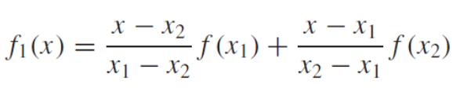
function yint = Lagrange(x,y,xx)
% Lagrange: Lagrange interpolating polynomial
% yint = Lagrange(x,y,xx): Uses an (n - 1)-order
% Lagrange interpolating polynomial based on n data points
% to determine a value of the dependent variable (yint) at
% a given value of the independent variable, xx.
% input:
% x = independent variable
% y = dependent variable
% xx = value of independent variable at which the
% interpolation is calculated
% output:
% yint = interpolated value of dependent variable
n = length(x);
if length(y)~=n, error('x and y must be same length'); end
s = 0;
for i = 1:n
product = y(i);
for j = 1:n
if i ~= j
product = product*(xx-x(j))/(x(i)-x(j));
end
end
s = s+product;
end
yint = s;
n = 2 → 1st order
n = 3 → 2nd order

Slide 9
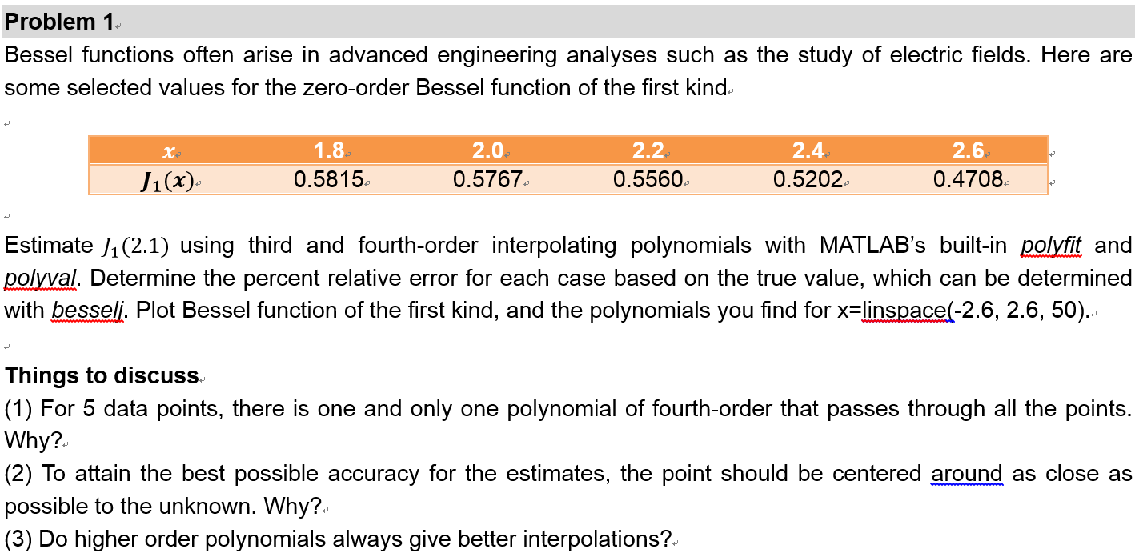

J = besselj(nu,Z) computes the Bessel function of the first kind, Jν(z), for each element of the array Z.
Let’s us nu = 1 for the zero-order Bessel function of the first kind, which means the true value of J₁(2.1) is equal to bessilj(1, 2.1)

Slide 10
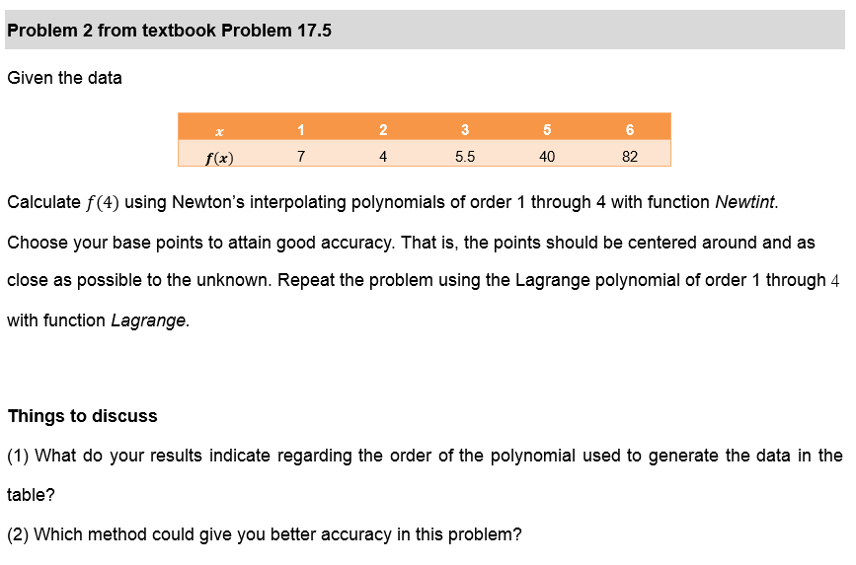
Please calculate f(4) by using both Newton’s interpolating polynomial and Lagrange polynomial of order 1 through 4.

Slide 11
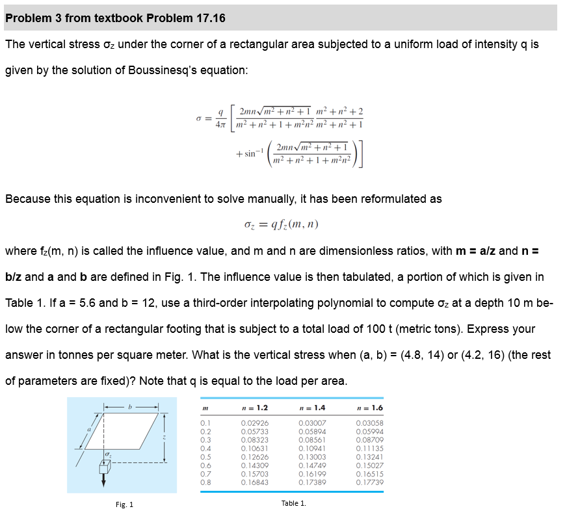

Slide 12
You don’t need to do multi-variable interpolation, because we already specify n, for example, n = 1.2. Then the $f_{z}\left(0.56,1.2\right)$ can be calculated using interpolation with the fz values in the first column (n = 1.2).
$$f_{z}\left(0.42,1.2\right)$$
Calculate these values by interpolation
$$f_{z}\left(0.56,1.2\right)$$
$$f_{z}\left(0.48,1.2\right)$$
$$σ_{1}=qf_{z}\left(0.56,1.2\right)$$
$$σ_{2}=qf_{z}(0.48,1.4)$$
$$σ_{3}=qf_{z}(0.42,1.6)$$

